Slide 1
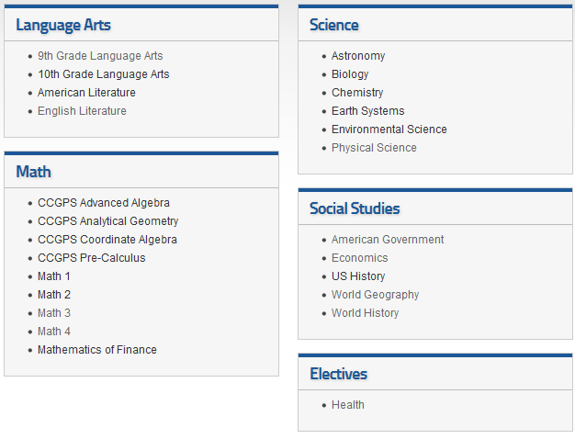
Shiloh High School ON-LINE Credit RECOVERY- FALL 2015 Seniors ONLY
Registration on My Payments Plus
10/13 - 10/23
For more info contact:
Mr. Johnson
770-736-2087
Kenton_Johnson@gwinnett.k12.ga.us
Courses Offered:
Tuition (per class):
$50.00 / 0.50 Credit
Students must have a final grade of 60-69 to qualify.
Students must complete 12 contact hours to receive final grade.
Fall Session Online Credit Recovery Dates
October 19th – November 19th
Times: (2:30pm - 4:00pm) Monday - Thursday

